Slide 1
BIOSTATISTICS AND
RESEARCH METHODOLOGY

Slide 2
Data
Data Is "Facts Or Figures From Which Conclusions Can Be Drawn".
For Example:
The Daily Weight Measurements Of Each Individual In Your Classroom;
The City's Temperature (Measured Every Hour) For A One-week Period.
Information
Data that have been recorded, classified, organized, related, or interpreted within a framework
For Example:
The number of persons in a group in each weight category (20 to 25 kg, 26 to 30 kg, etc.);
The number of days during the week where the temperature went above 20°C.
Statistics
Statistics is a collection of methods for collecting, displaying, analyzing, and drawing conclusions from data/Information.

Slide 3
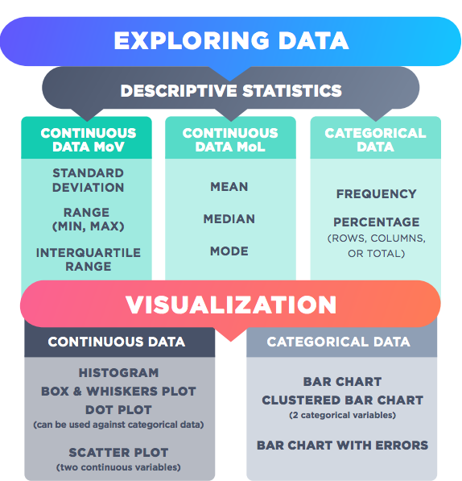
What are Statistical Measures?
4

Slide 4
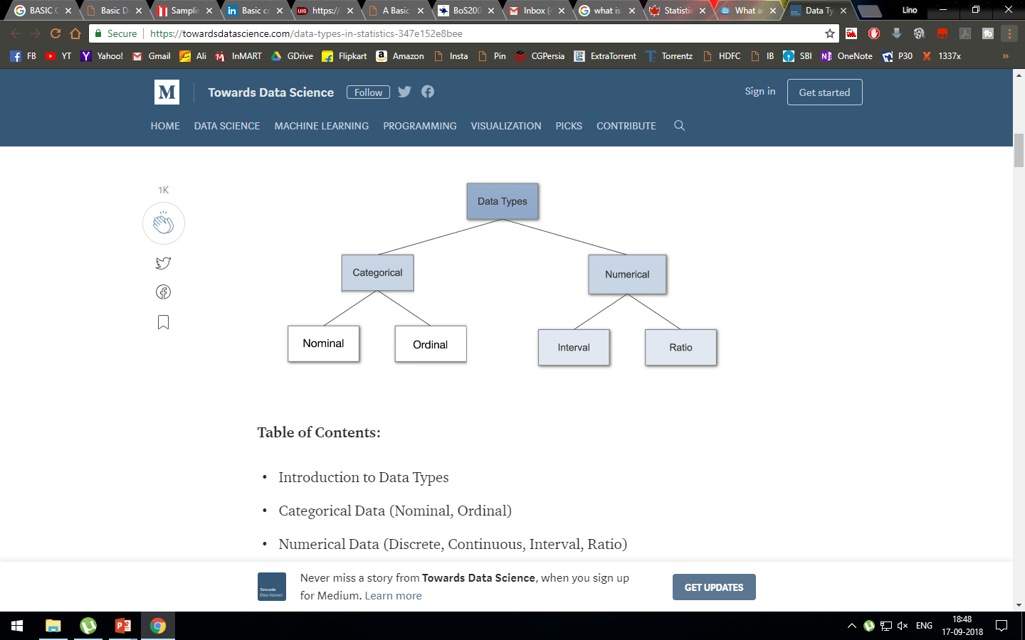
Statistical variables/Data types

Slide 5
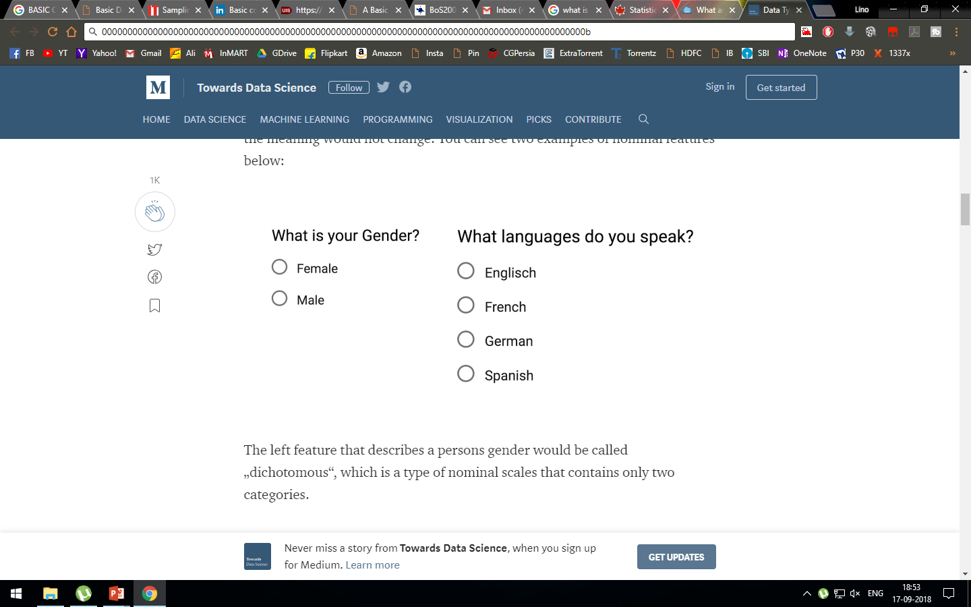
Categorical Data
Categorical data represents characteristics. Therefore it can represent things like a person’s gender, language etc. Categorical data can also take on numerical values (Example: 1 for female and 0 for male).
Nominal Data
Nominal values represent discrete units and are used to label variables, that have no quantitative value.

Slide 6

Ordinal Data
Ordinal values represent discrete and ordered units.

Slide 7
Numerical Data
Discrete Data
This type of data can’t be measured but it can be counted.
2. Continuous Data
Continuous Data represents measurements and therefore their values can’t be counted but they can be measured.

Slide 8
Important Terms:
Population:
A population is any specific collection of objects of interest.
Sample
A sample is any subset or subcollection of the population, including the case that the sample consists of the whole population, in which case it is termed a census.
Measurement
A measurement is a number or attribute computed for each member of a population or of a sample. The measurements of sample elements are collectively called the sample data.
Parameter
A parameter is a number that summarizes some aspect of the population as a whole. A statistic is a number computed from the sample data.

Slide 9
Identify each of the following data sets as either a population or a sample:
The grade point averages (GPAs) of all students at a college.
The GPAs of a randomly selected group of students on a college campus.
The ages of the nine Supreme Court Justices of the United States on January 1, 1842.
The gender of every second customer who enters a movie theater.
The lengths of Atlantic croakers caught on a fishing trip to the beach.
Answer:
population
sample
sample
sample
sample

Slide 10
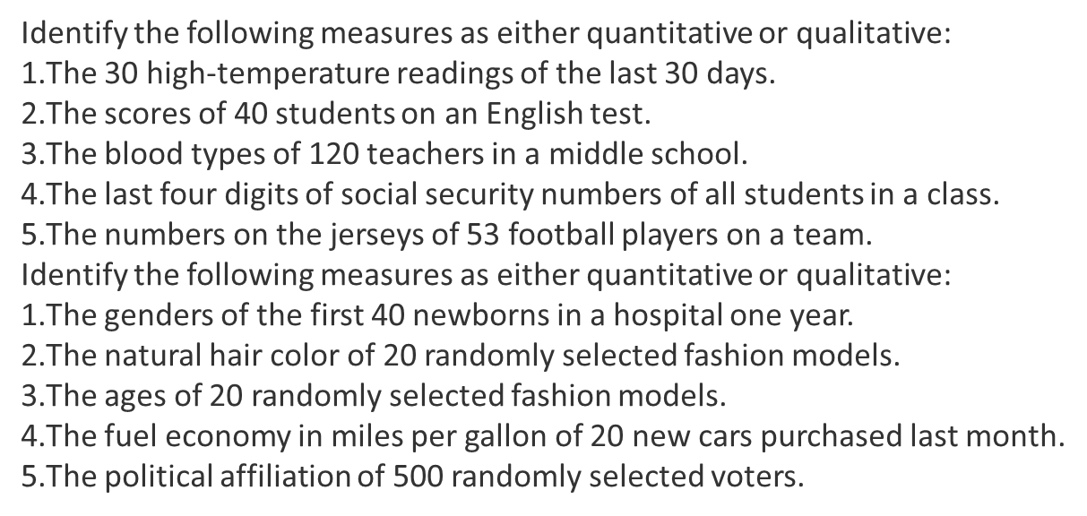

Slide 11

Population
Sample
Sampling
μ
σ²
Ѕ²
Generalization
Parameter
Statistic

Slide 12
Why sample?
Lower cost
Greater accuracy of results
Greater speed of data collection
Availability of population elements
Sample vs. Census

Slide 13
Sampling Process
Steps in Sampling Process
An operational sampling process can be divided into seven steps as given below:
Defining the target population.
Specifying the sampling frame.
Specifying the sampling unit.
Selection of the sampling method.
Determination of sample size.
Selecting the sample.

Slide 14
1.Target Population
group to which you wish to generalize the results of the study
should be defined as specifically as possible
population
sampling
frame
sample

Slide 15
2. Sampling Frame
  the list of elements from which the sample is actually drawn

Slide 16
3. Specifying the Sampling Unit:
A sampling unit is a basic unit that contains a single element or a group of elements of the population to be sampled.
4. Selection of the Sampling Method:
The sampling method outlines the way in which the sample units are to be selected.
5. Determination of Sample Size:
The sample size plays a crucial role in the sampling process. There are various ways of classifying the techniques used in determining the sample size.
6. Selecting the Sample:
This is the final step in the sampling process, where the actual selection of the sample elements is carried out.

Slide 17
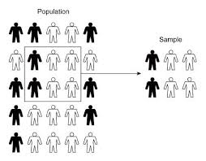

Slide 18
Census
A census is a study of every unit, everyone or everything, in a population. It is known as a complete enumeration, which means a complete count.

Slide 19
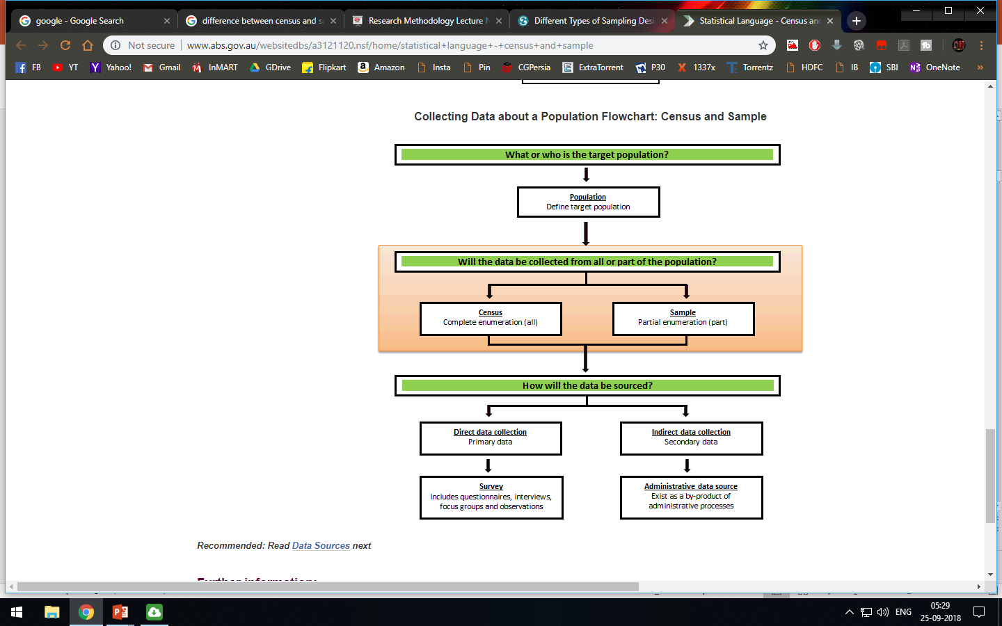

Slide 20
Sampling Techniques
Probability Sampling (random sampling)
Nonprobability Sampling (nonrandom sampling)

Slide 21
Probability Sampling
sample should represent the population
using random selection methods
members of the population have a known and non-zero chance of being selected (EPSEM: Equal Probability of SElection Method)

Slide 22
Types of Probability Sampling
Simple random sampling
Systematic sampling
Stratified sampling
Cluster sampling
Multistage sampling

Slide 23
Simple Random Sampling
every unit in the population has an equal and known probability of being selected as part of the sample

Slide 24
Random Numbers Table
a table of random digits arranged in rows and columns
after assigning an identification number to each member of the population, numbers in the random numbers table are used to select those who will be in the sample

Slide 25
 | 1 | 2 | 3 | 4 | 5 | 6 | 7 | 8 | 9 | 10
1 | 49486 | 93775 | 88744 | 80091 | 92732 | 38532 | 41506 | 54131 | 44804 | 43637
2 | 94860 | 36746 | 04571 | 13150 | 65383 | 44616 | 97170 | 25057 | 02212 | 41930
3 | 10169 | 95685 | 47585 | 53247 | 60900 | 20097 | 97962 | 04267 | 29283 | 07550
4 | 12018 | 45351 | 15671 | 23026 | 55344 | 54654 | 73717 | 97666 | 00730 | 89083
5 | 45611 | 71585 | 61487 | 87434 | 07498 | 60596 | 36255 | 82880 | 84381 | 30433
6 | 89137 | 30984 | 18842 | 69619 | 53872 | 95200 | 76474 | 67528 | 14870 | 59628
7 | 94541 | 12057 | 30771 | 19598 | 96069 | 10399 | 50649 | 41909 | 09994 | 75322
8 | 89920 | 28843 | 87599 | 30181 | 26839 | 02162 | 56676 | 39342 | 95045 | 60146
9 | 32472 | 32796 | 15255 | 39636 | 90819 | 54150 | 24064 | 50514 | 15194 | 41450
10 | 63958 | 47944 | 82888 | 66709 | 66525 | 67616 | 75709 | 56879 | 29649 | 07325

Slide 26
Characteristics of simple random sampling
Unbiased
Independence

Slide 27
Limitations of simple random samples
not practical for large populations
Simple random sampling becomes difficult when we don’t have a list of the population

Slide 28
Systematic Sampling
a type of probability sampling in which every k^{th} member of the population is selected
k=N/n
  N = size of the population
  n = sample size

Slide 29
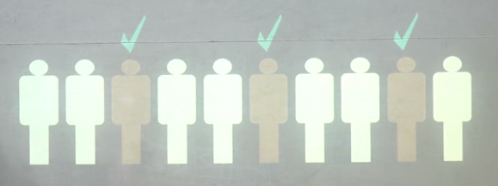

Slide 30
For example:
You want to obtain a sample of 100 from a
population of 1,000. You would select every
10th (or kth) person from the list.
k = 1000/100=10

Slide 31
Stratified Random Sample
Prior to random sampling, the population is divided into subgroups, called strata, e.g., gender, ethnic groups, professions, etc.
Subjects are then randomly selected from each strata (using simple random sampling)

Slide 32


Slide 33
Why use stratified samples?
permits examination of subgroups by ensuring sufficient numbers of subjects within subgroups
generally more convenient than a simple random sample

Slide 34
Cluster Sampling
used when subjects are randomly sampled from within a “unit” or “group” (e.g., classroom, school, country, etc)

Slide 35
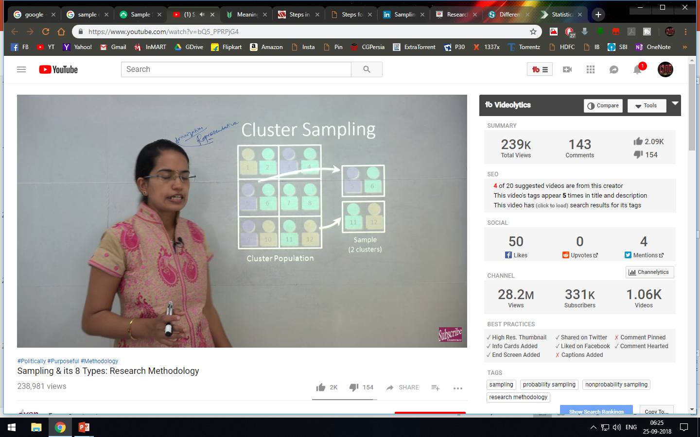

Slide 36
Multistage sampling
Multi-stage sampling (also known as multi-stage cluster sampling) is a more complex form of cluster sampling which contains two or more stages in sample selection.

Slide 37
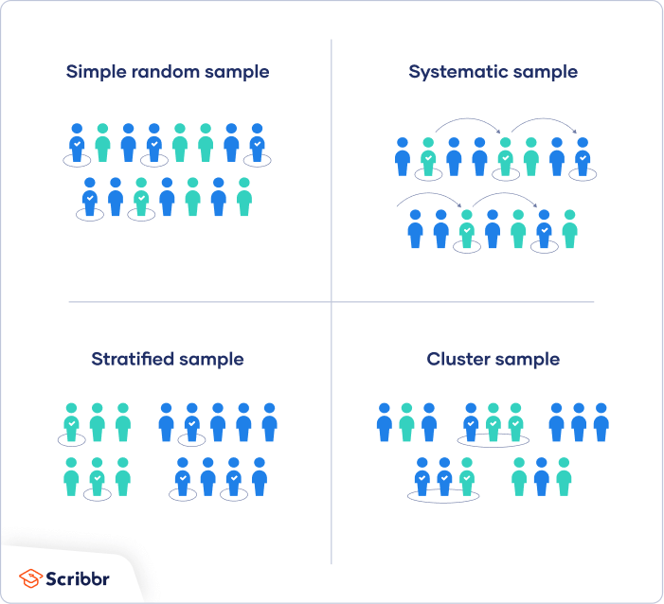

Slide 38
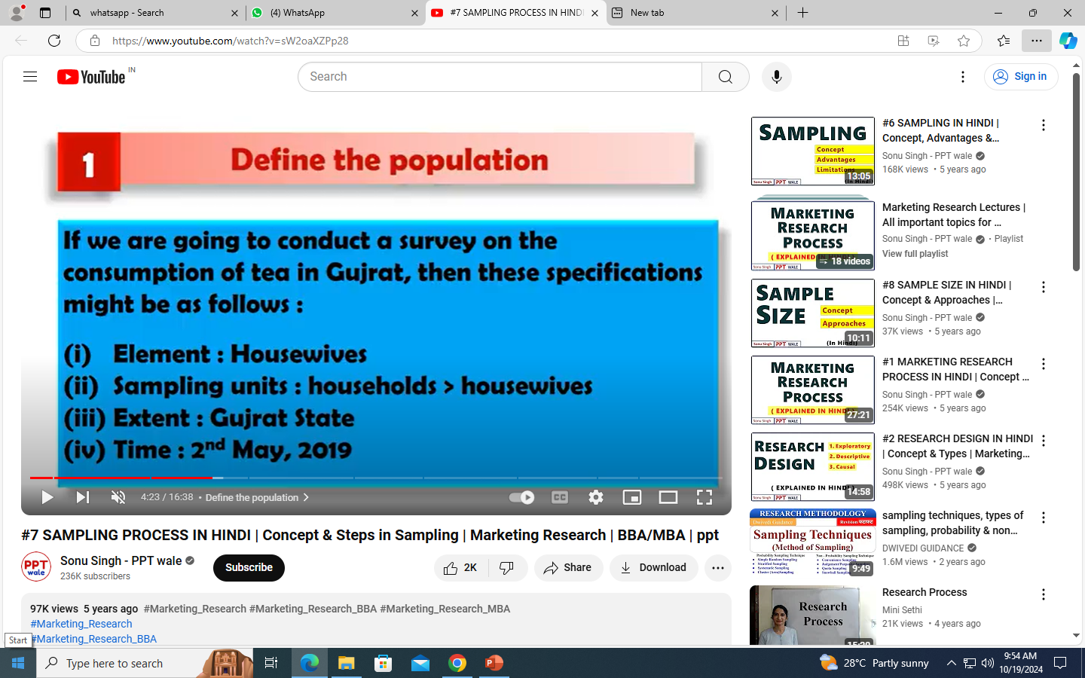
Example:

Slide 39

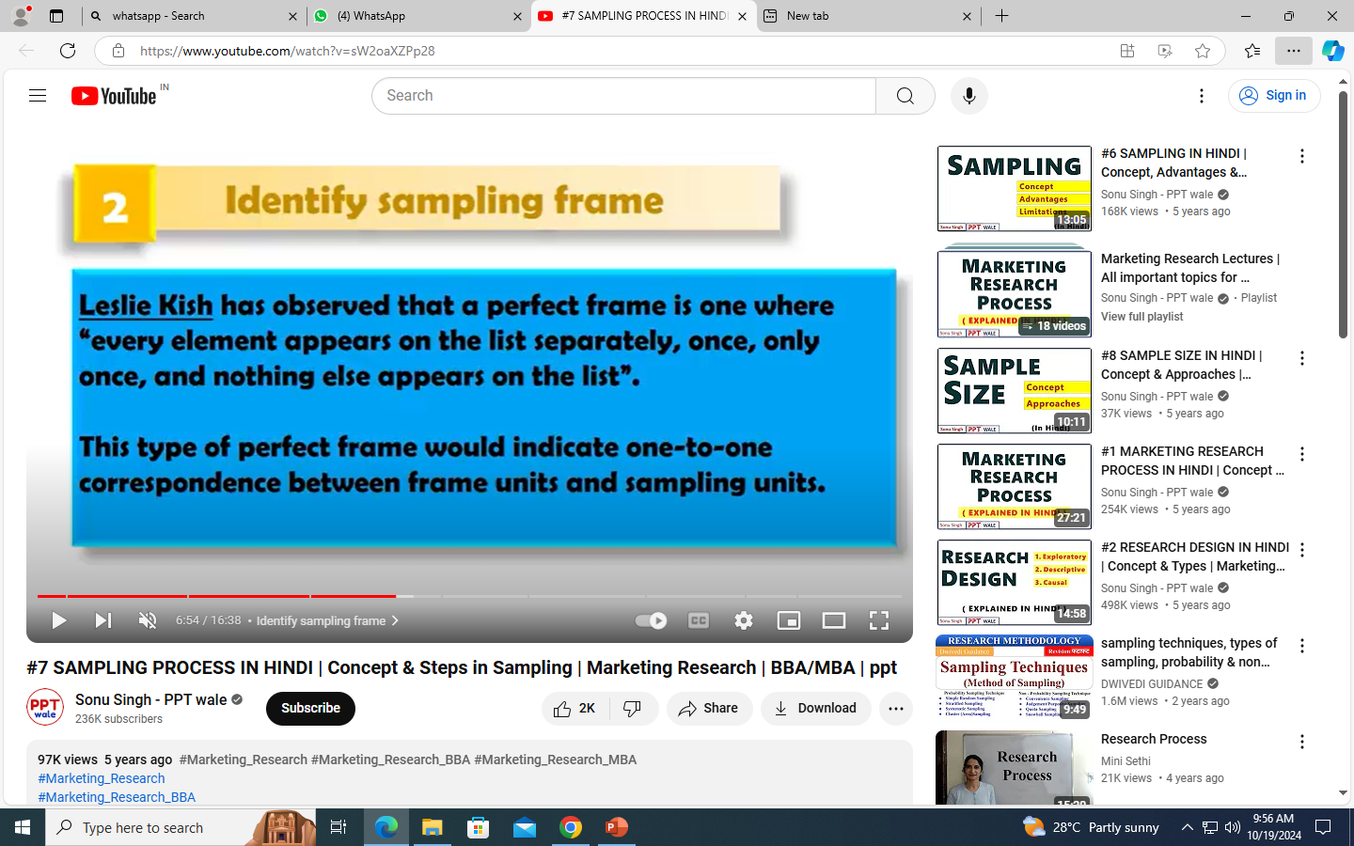

Slide 40
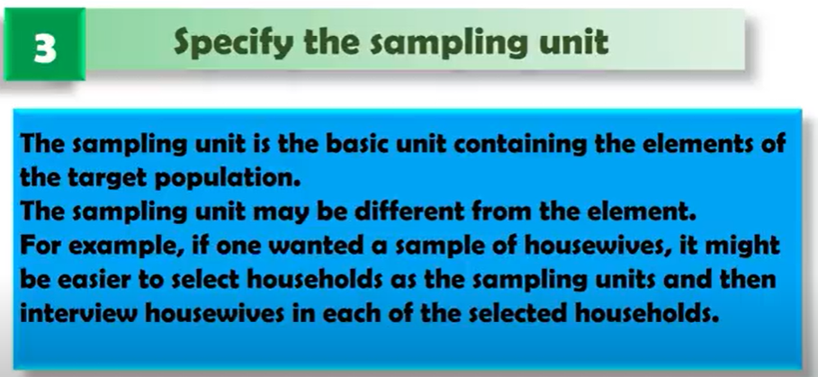

Slide 41
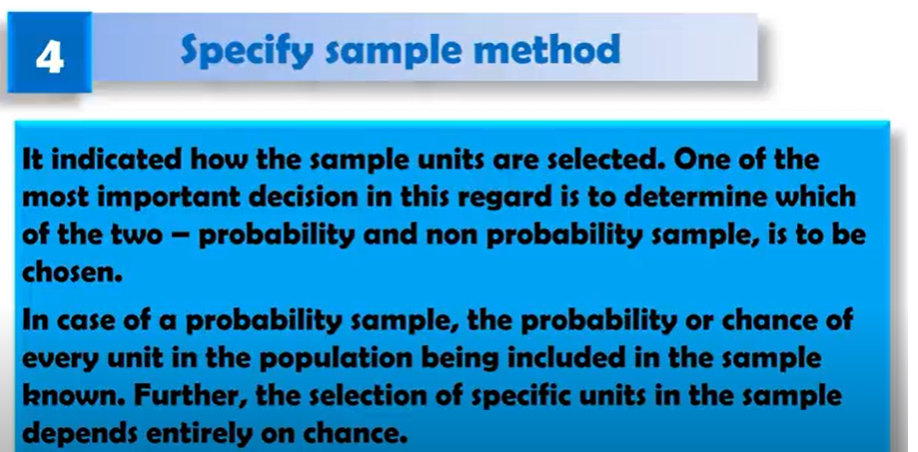
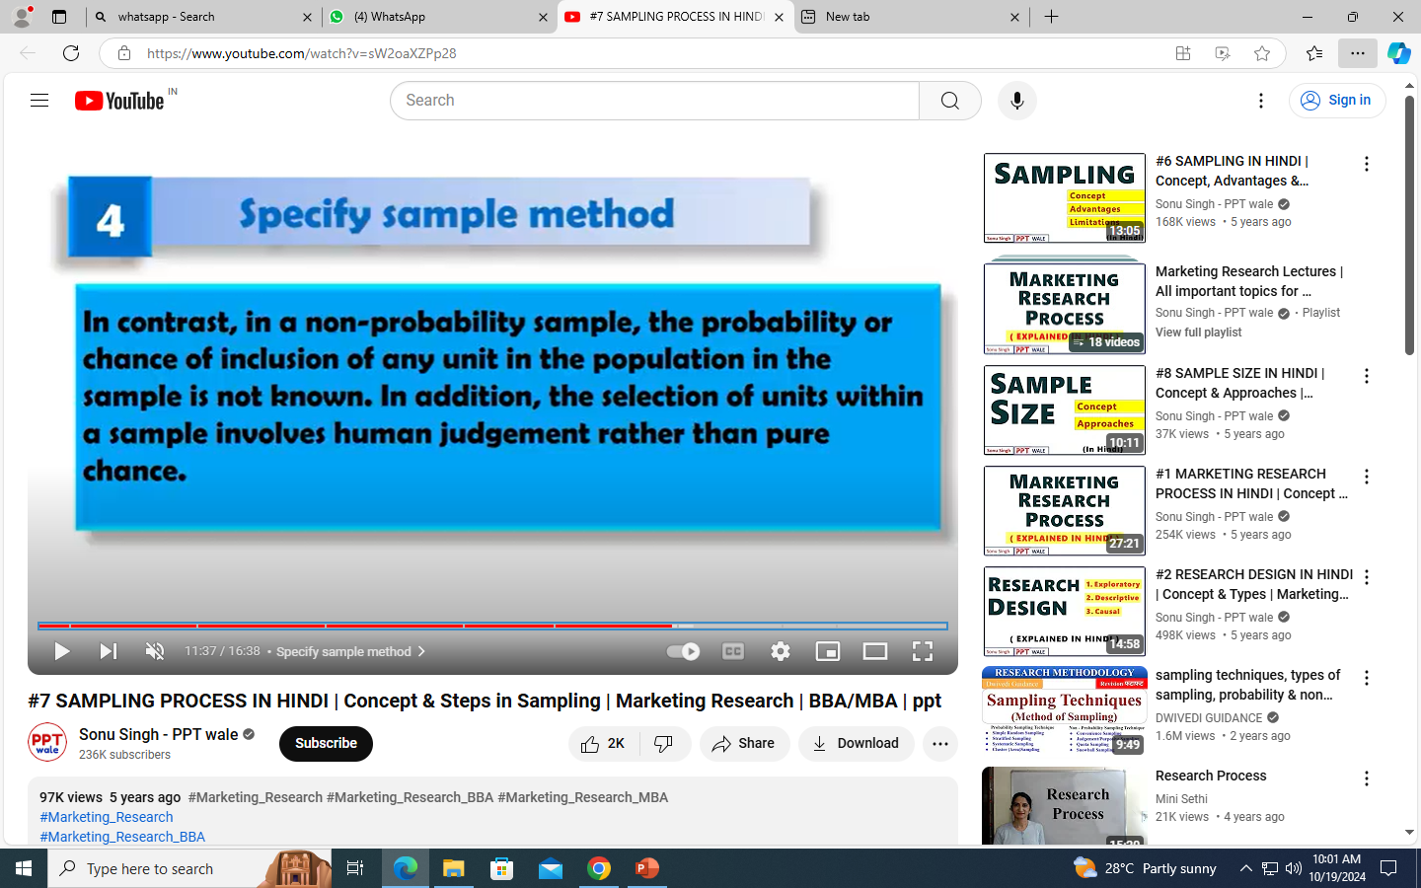

Slide 42
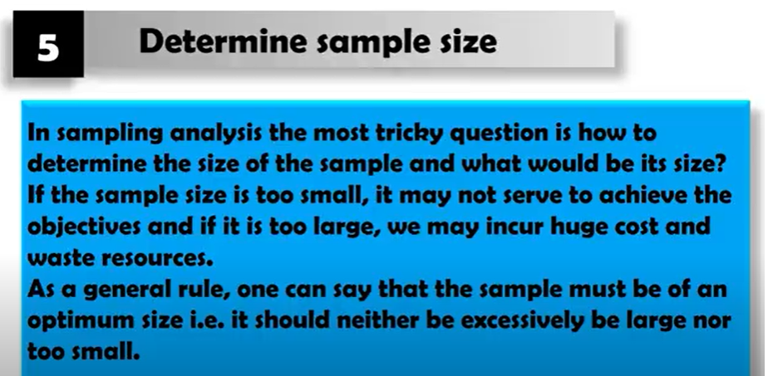

Slide 43
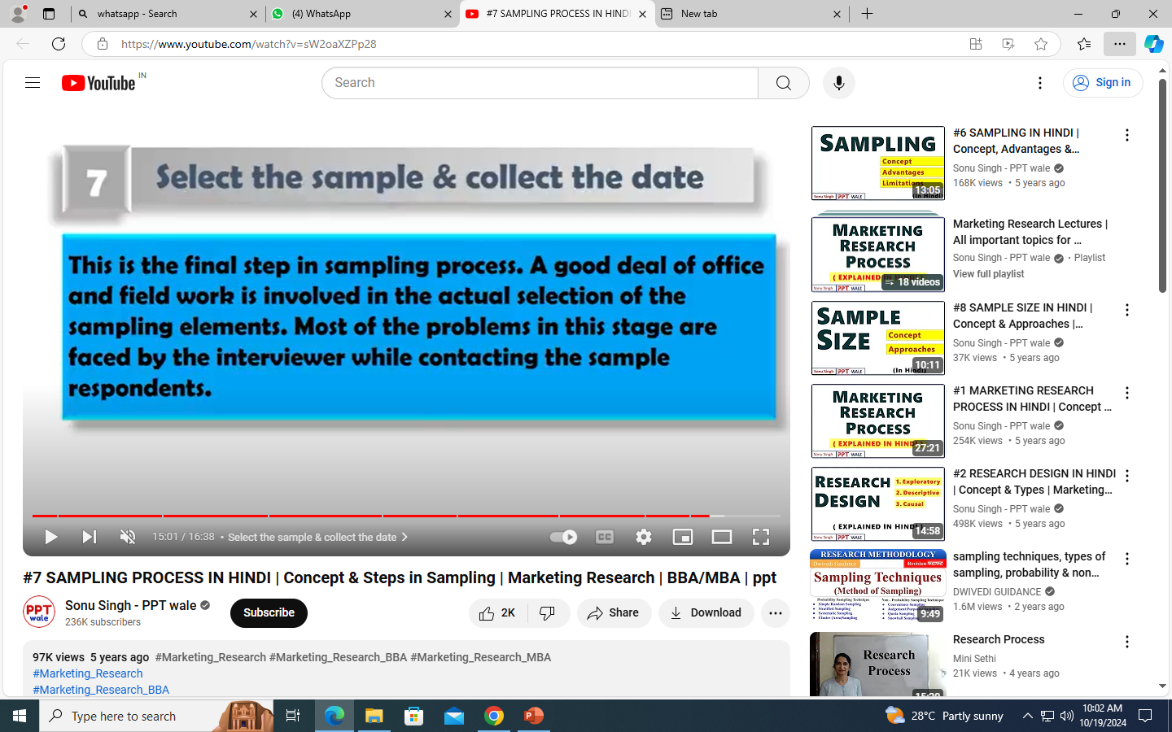

Slide 44
Concept of Sample Size and Power

Slide 45
Calculate sample size:
n=N/(1+Ne^2)

Slide 46
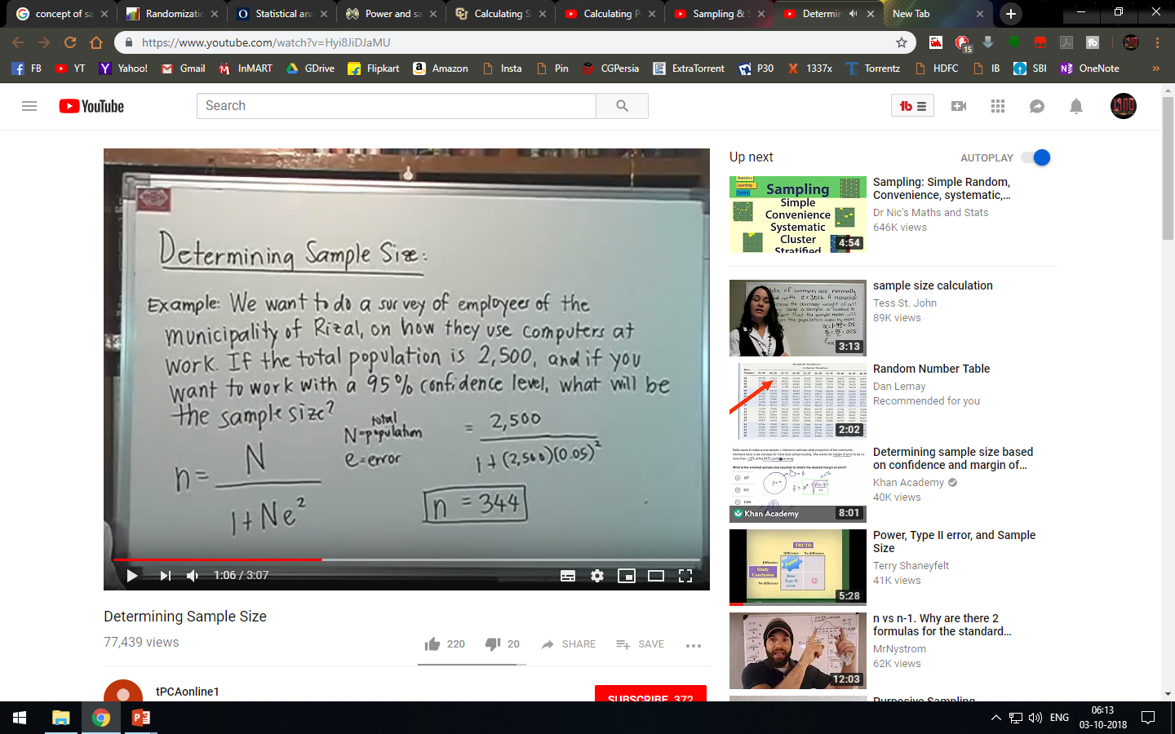

Slide 47
HYPOTHESIS
A statistical hypothesis is an assumption about a population which may or may not be true.
Terms:
Population: Well-defined collection of objects
Eg: People,product etc
Sample: Part of population which used for research
Test of Significance: Testing Significance of samples which is done by Hypothesis Testing

Slide 48
Sources of Formulation of Hypothesis
A hypothesis may be formulated through a number of is sources. Following are the main sources of hypothesis.
Personal Experience
Imagination & Thinking
Observation
Scientific Theory
Previous Study
Culture

Slide 49
HYPOTHESIS TESTING
Hypothesis testing is a set of formal procedures used by statisticians to either accept or reject
statistical hypothesis.
HYPOTHESIS ARE OF TWO TYPES:
Null hypothesis, H0 - No difference between observed and theoretical
Alternative hypothesis, H1 - difference between observed and theoretical

Slide 50
Level of significance
The confidence interval at which a null hypothesis is accepted or rejected is called level of significance. The level of significance is denoted by α(95%,99% or 90%)
Types of Errors
Type I error(alpha)
Two types of errors are normally committed while testing the hypothesis using the sample data. If the null hypothesis is rejected when it is true, then the error committed is known as type I error.
Type II error(beta)
When the analyst has failed to reject the null hypothesis even when it is false then type II error is committed.

Slide 51
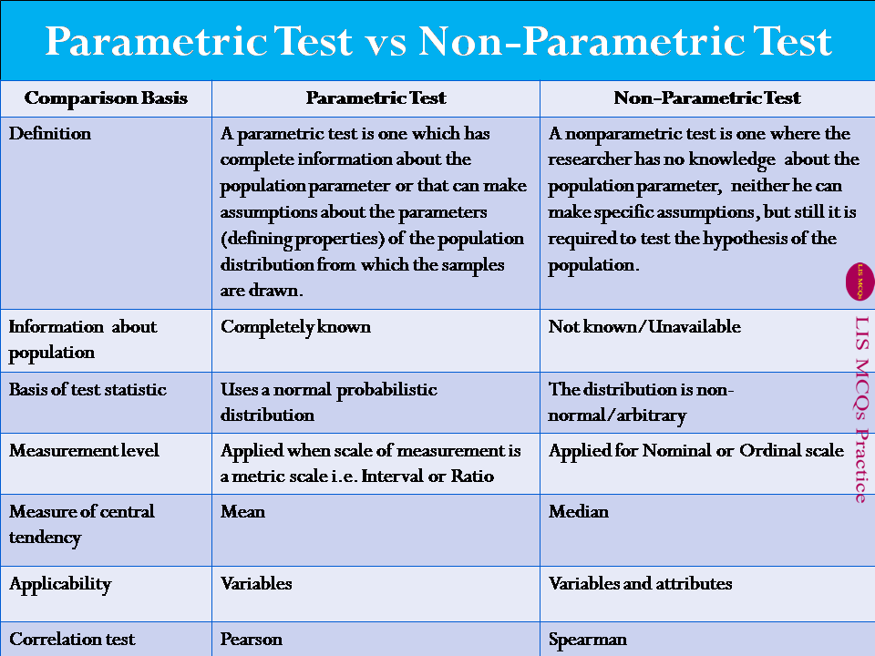

Slide 52
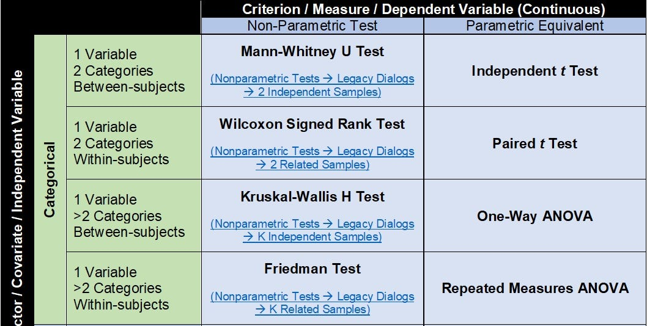

Slide 53
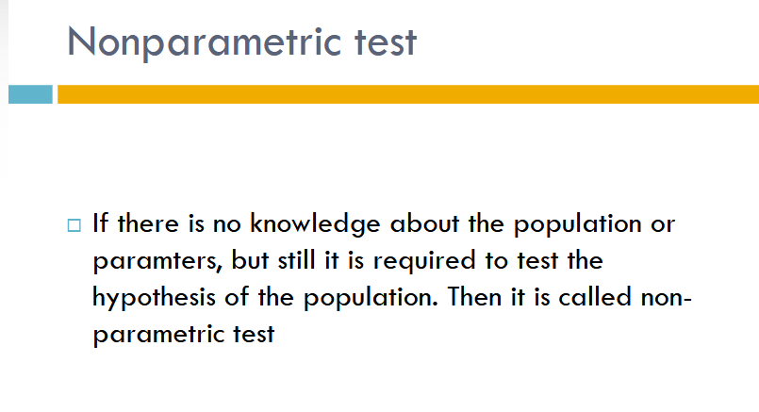

Slide 54
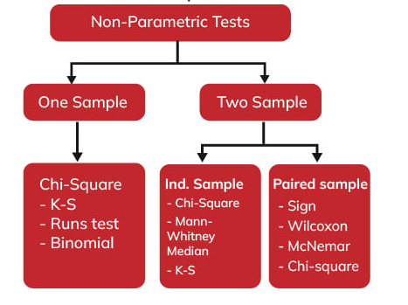

Slide 55

Thank you !
22

